Slide 1

Onshape Quirks Workshop
2021 - 2022

Slide 2
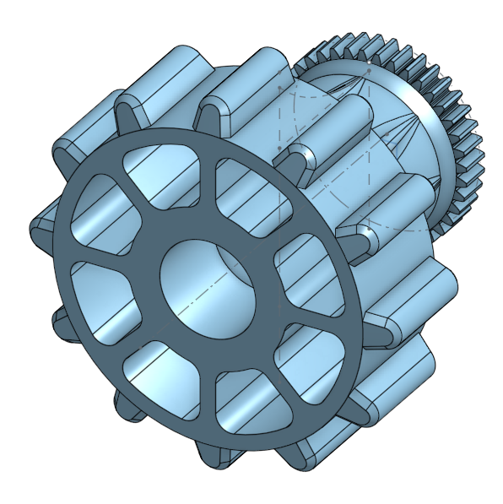
Overview
Introduction
Part Studios and Assemblies
Variables
Versions
Branches
Collaboration
Activity

Slide 3

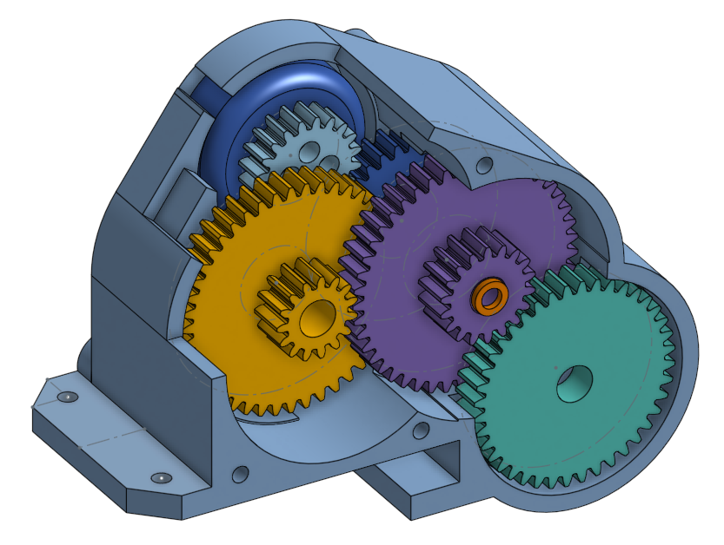
Introduction
This workshop will go over some of the useful features Onshape has and how they can be applied to your workflow and future projects.
At the end of the workshop, there will be a quick activity to walk you through the steps yourself.

Slide 4
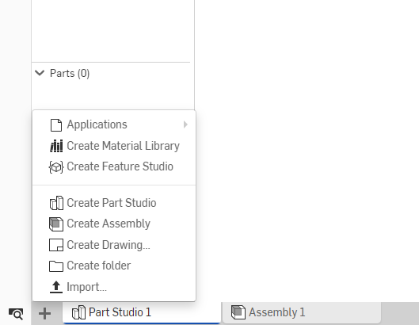
Part Studios and Assemblies
You will find them in the bottom left of your screen
Part studios - where you create your parts.
Assemblies - where you mate your created parts together.
You can have many separate part studios and assemblies in one document.

Slide 5
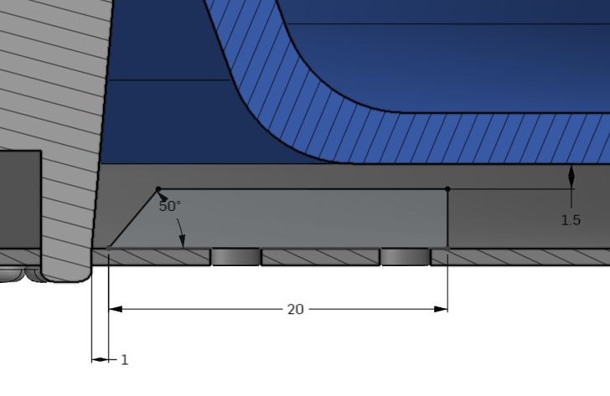
Part Studios and Assemblies (Continued)
A couple of interesting notes to consider while working in Onshape:
Unlike SolidWorks, Onshape allows you to dimension sketches off another part.
Very useful for tolerancing for 3D printing (as shown in the picture).

Slide 6
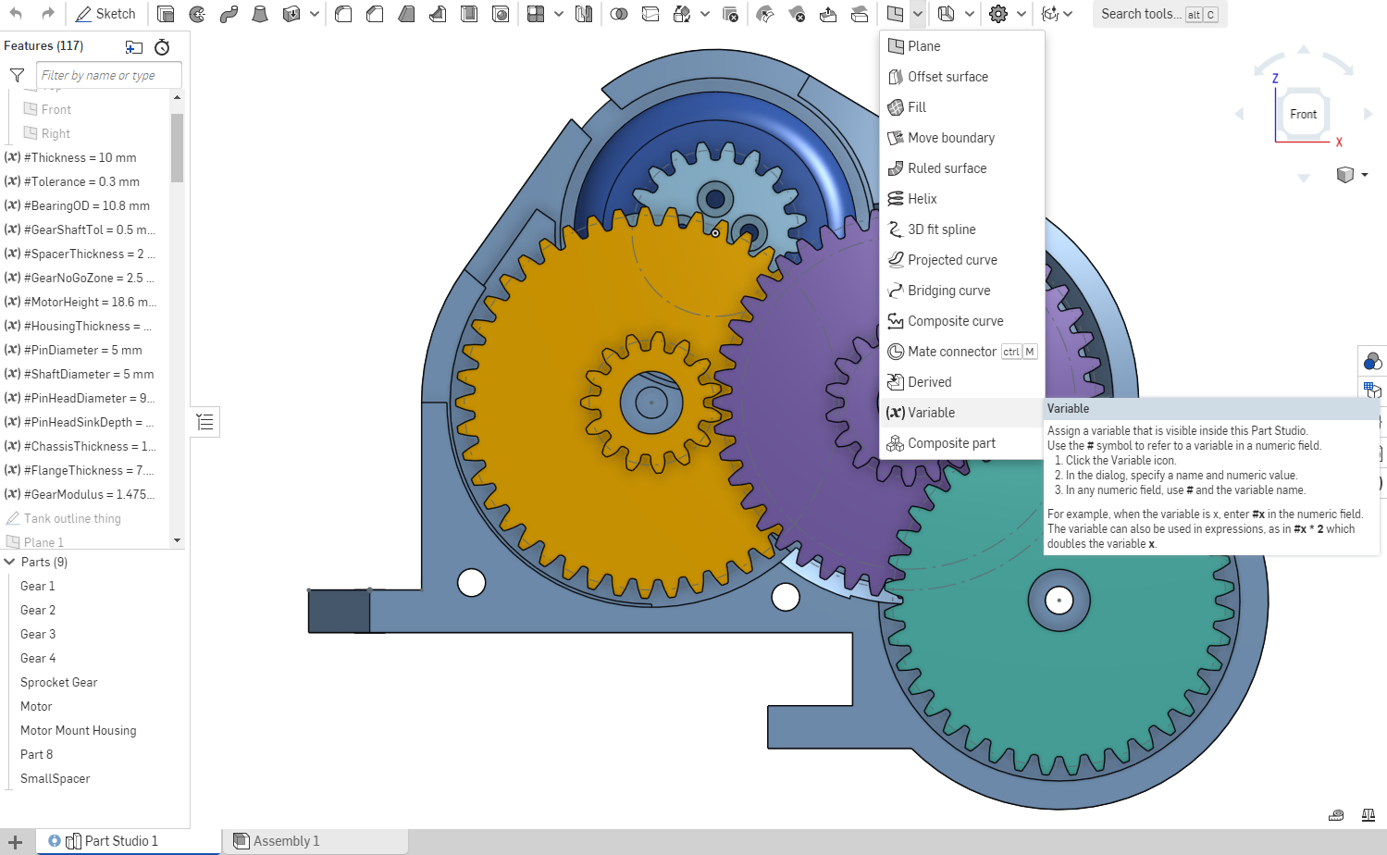
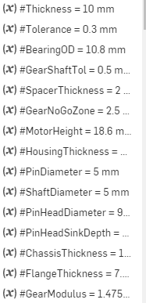
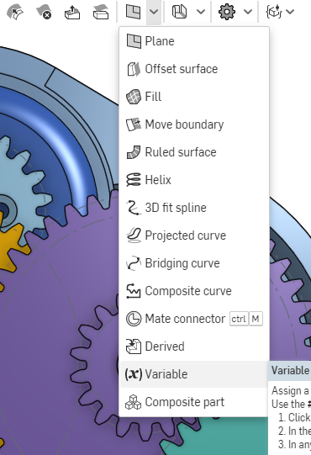
Variables
In Onshape, variables allow you to define a length or angle etc. and use these to dimension sketches.
Allows you to quickly change multiple dimensions on your part without editing each sketch.
Very useful if multiple dimensions need to have the same value.

Slide 7
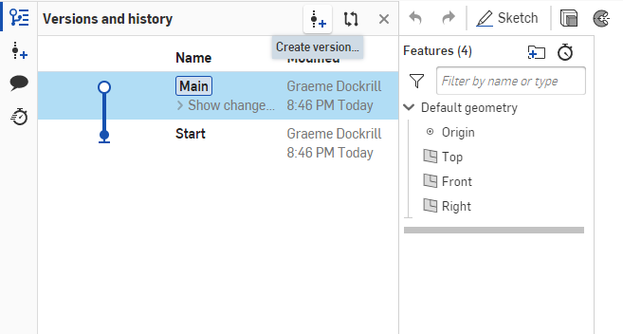
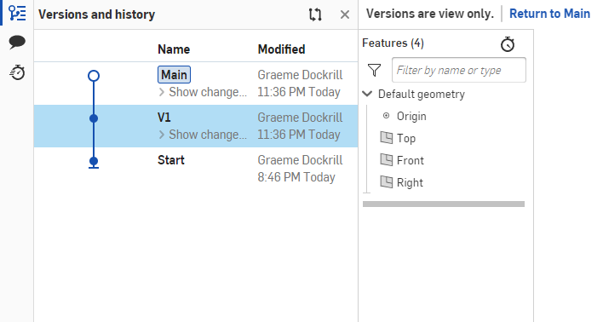
Versions
Versions allow you to save your model at certain times and revert to them later.
You will find the versions menu in the top left of the screen.
Versions save across all part studios and assemblies.
Versions are view only - they can’t be modified.

Slide 8
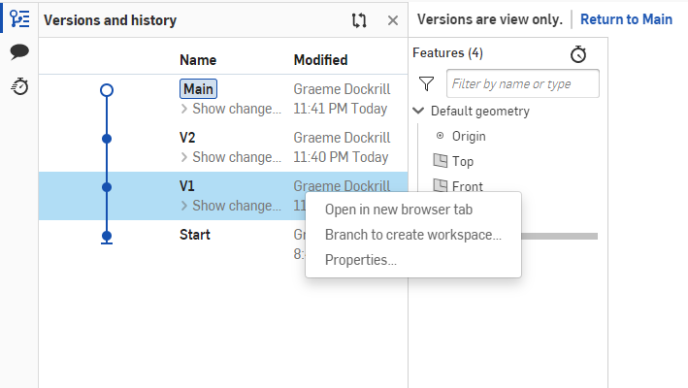
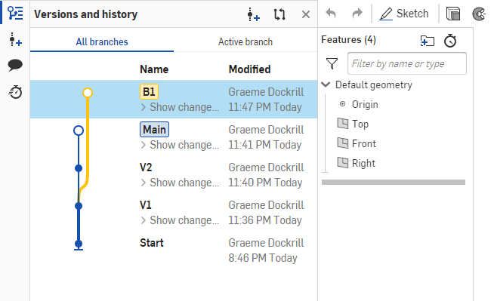
Branches
Branches allow you to split from one of your created versions and modify it separately.
You can create a branch by right clicking on your version.
Useful if you want to change something without breaking your main version.
Branches can be merged back to main.

Slide 9
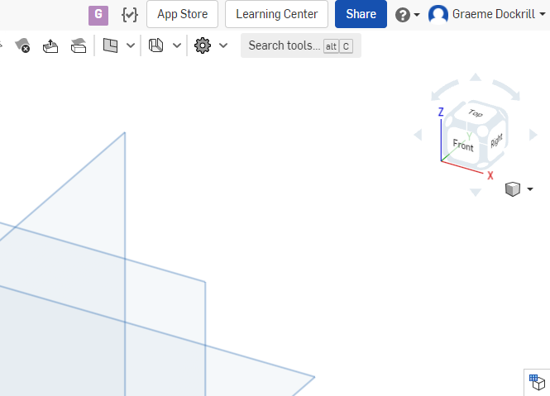
Collaboration
Onshape can also be used collaboratively, with multiple people working on the same document.
Other people can only see changes you’re making after you’ve made them (ex: Confirming a sketch).
Very useful when working in a group remotely.

Slide 10
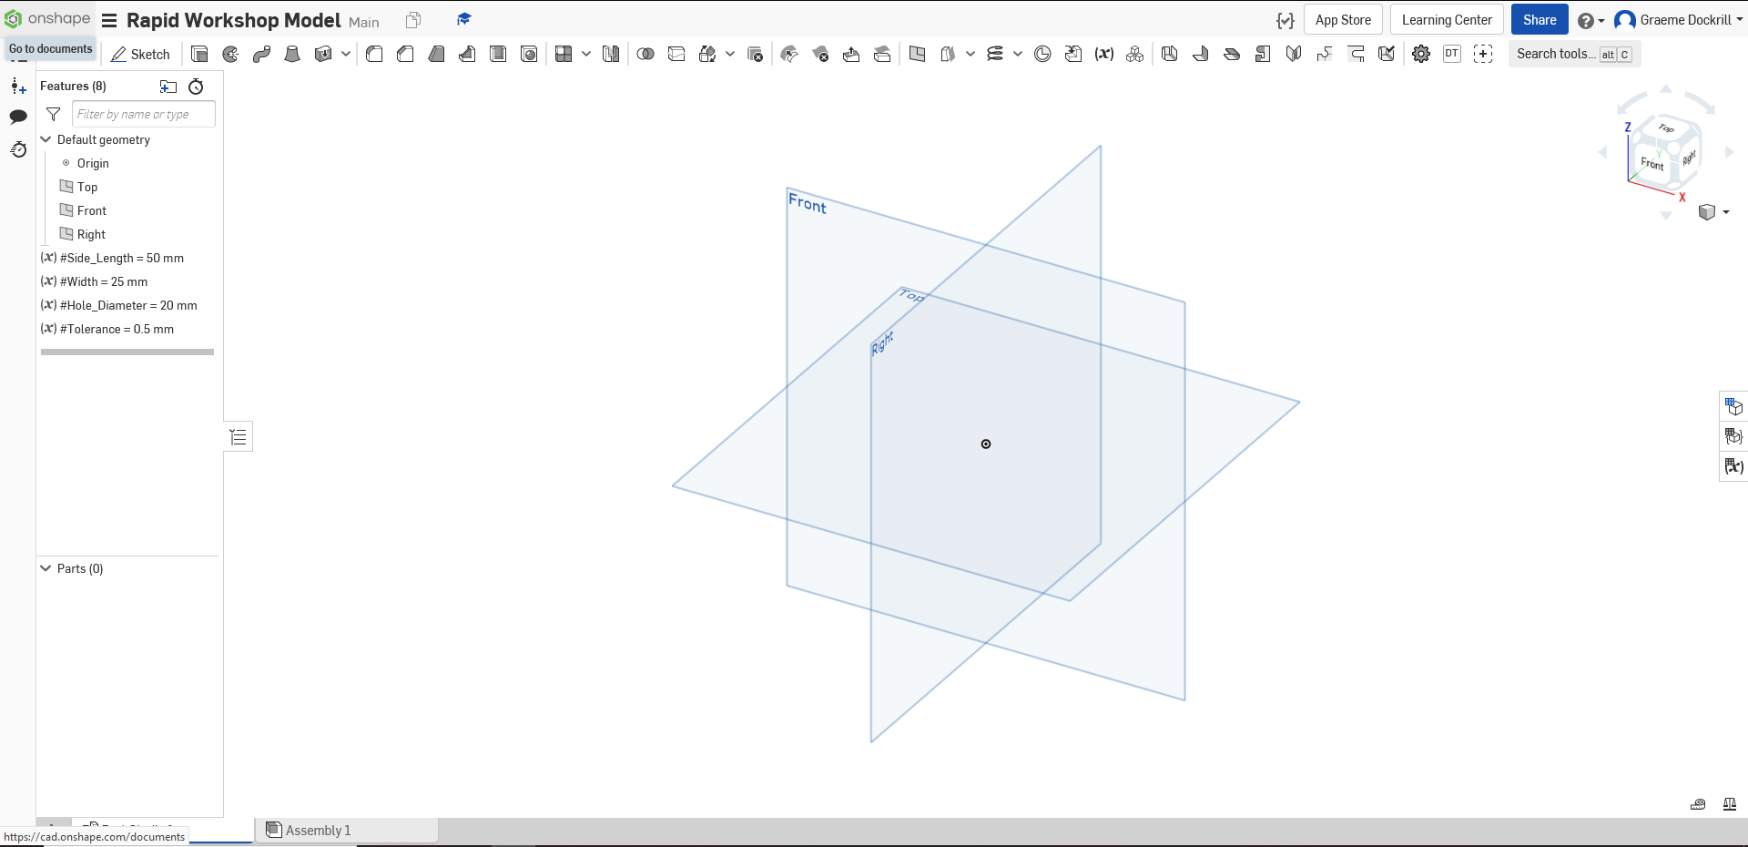
Activity 2.0
This activity is meant to get you comfortable working with the concepts from before.
Start with a fresh OnShape document
Create a variable and name it “Side_Length”; set it’s value to 50 mm
Create 3 more variables: “Width” = 25 mm, “Hole_Diameter” = 20 mm, “Tolerance” = 0.5 mm

Slide 11
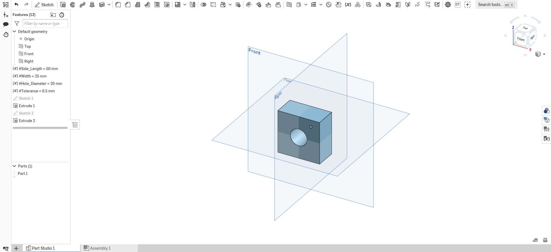
Activity 2.0 (Continued)
Sketch a square on the front plane and dimension the sides as “Side_Length”
Extrude the square out using “Width”
Sketch a circle on the front face of the square with diameter “Hole_Diameter”
Extrude the circle through the square to create a through-hole

Slide 12
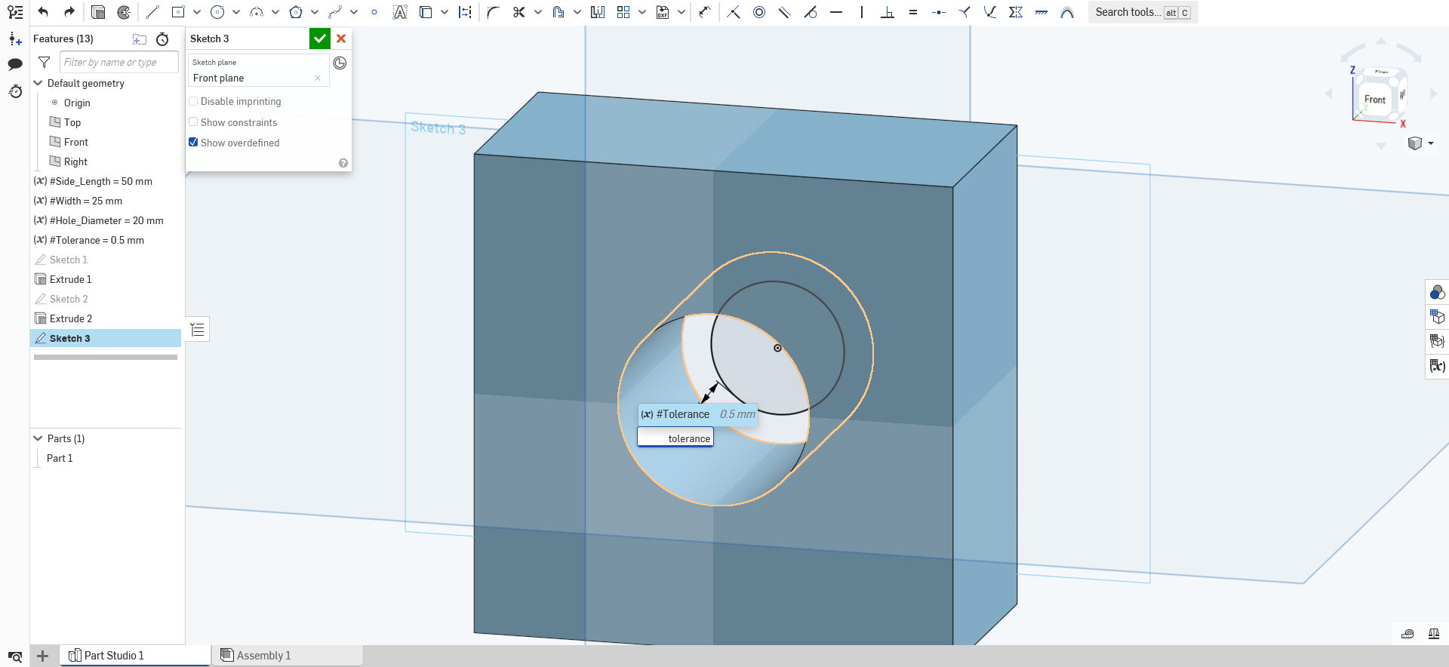
Activity 2.0 (Continued)
Start a sketch on the front plane
Sketch a circle centered inside the hole
Dimension the distance between the circle and the inner edge of the hole to be “Tolerance”

Slide 13
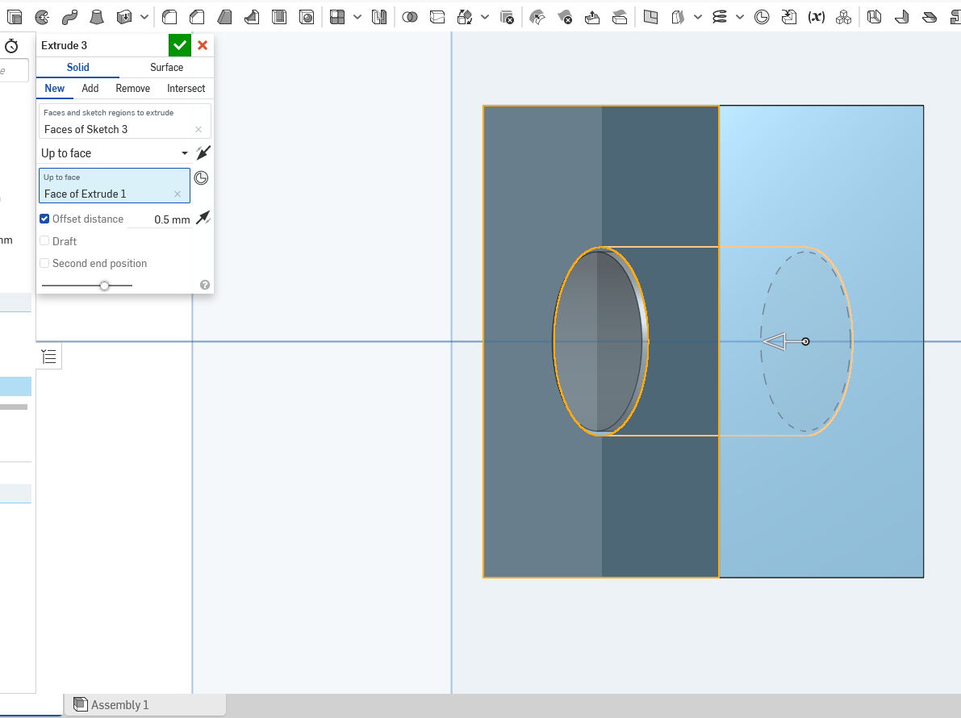
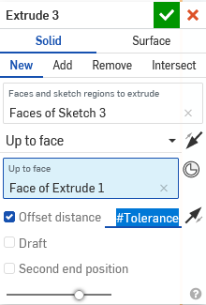
Activity 2.0 (Continued)
Extrude the circle
Select “Up to face” and select the front face of the square
Check “Offset distance” and use the dimension “Tolerance” to bring the extrusion past the face

Slide 14
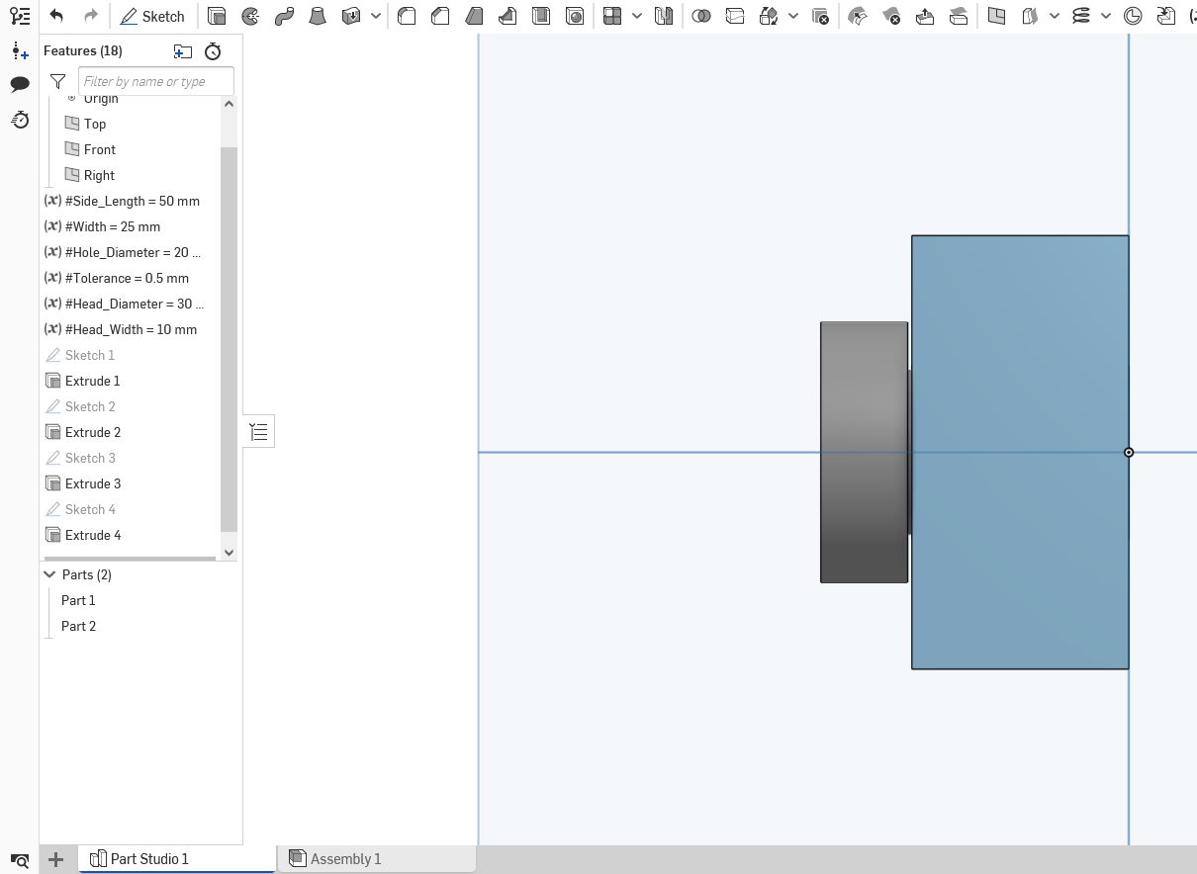
Activity 2.0 (Continued)
Create two new variables “Head_Diameter” = 30 mm, “Head_Width” = 10 mm
Drag the new variables in the feature tree and place them with your other variables
Create a sketch on the front face of the cylinder and draw a circle of diameter “Head_Diameter”
Extrude the circle by “Head_Width”

Slide 15
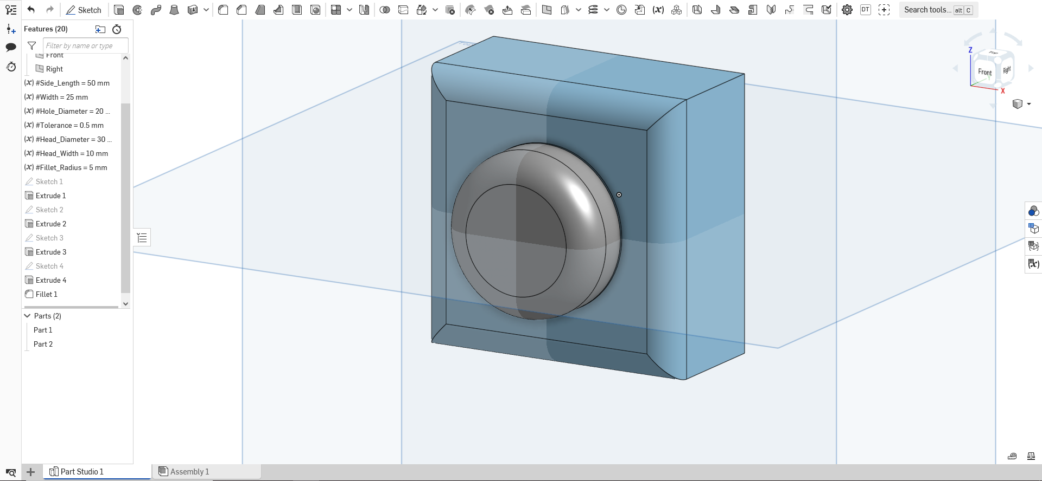
Activity 2.0 (Continued)
Now let’s add some nice fillets to the head and the edges of the square.
Create a new variable “Fillet_Radius” = 5 mm
Make sure the move the variable with the others
Apply the fillet to the top face of the head and the square

Slide 16
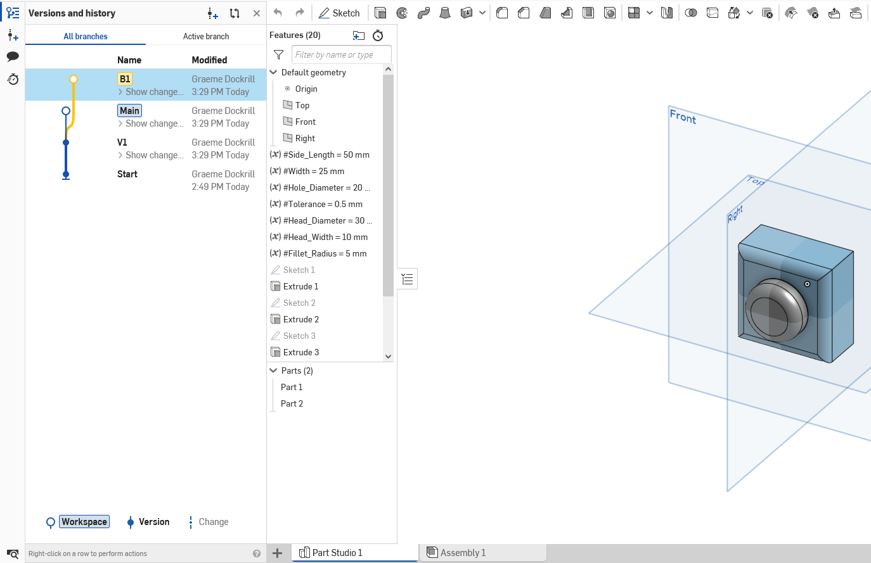
Activity 2.0 (Continued)
Now let’s see how versions and branches can be used here.
Create a new version and name it “V1”
Branch a new workspace from V1 and name it “B1”

Slide 17
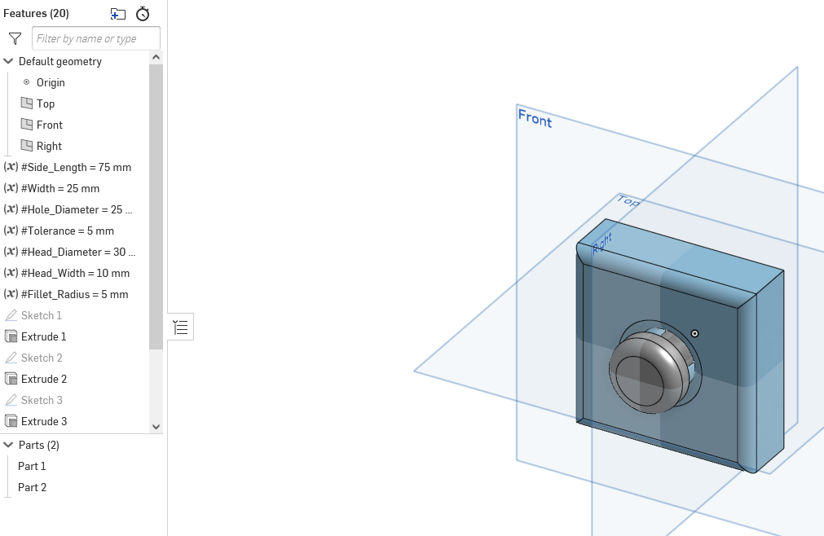
Activity 2.0 (Continued)
Let’s change some of those variables that we made earlier.
Change the value of “Side_Length” to 75 mm.
Change the value of “Hole_Diameter” to 25 mm
Change the value of “Tolerance” to 5 mm

Slide 18
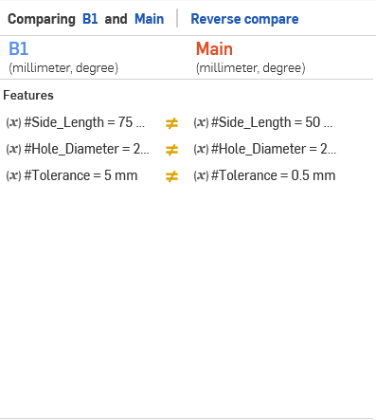
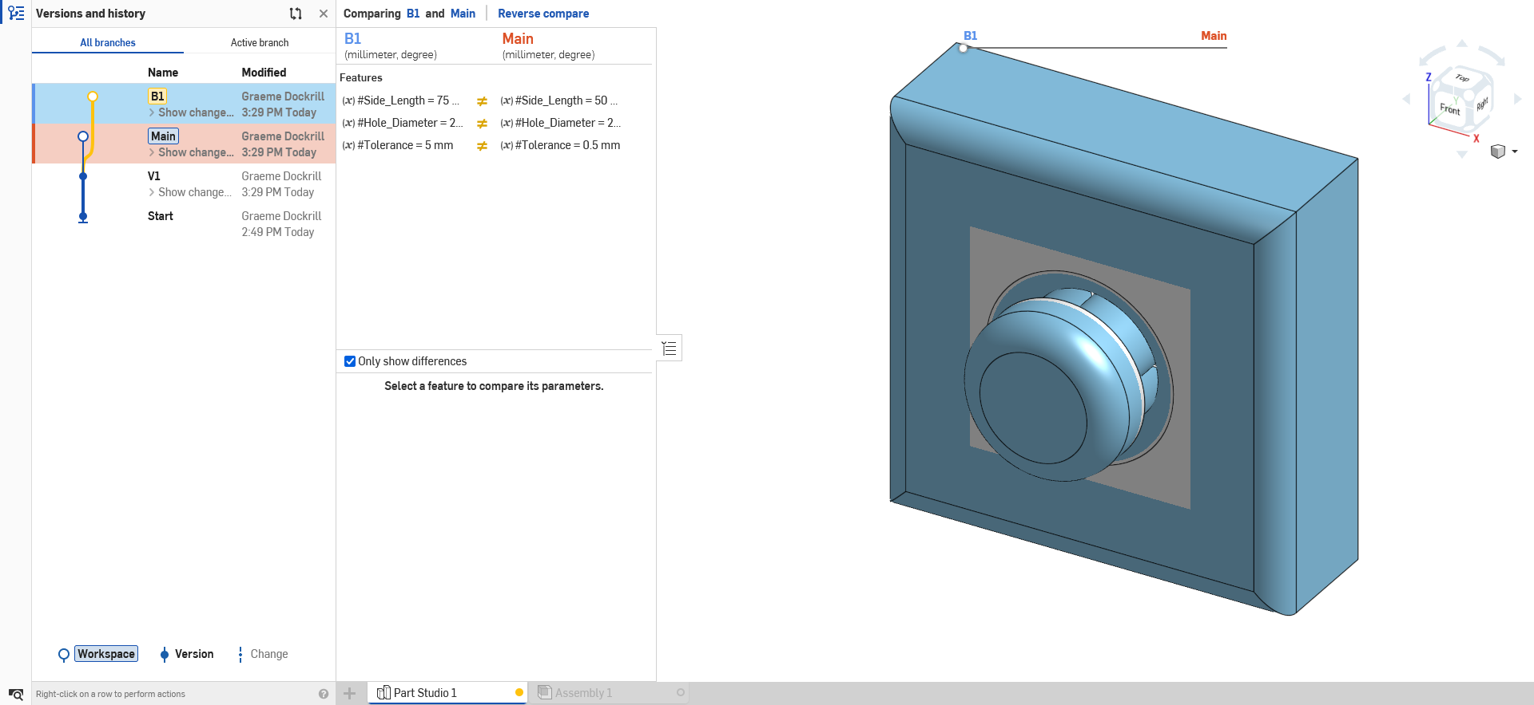
Activity 2.0 (Continued)
Let’s compare the changes between branches.
While B1 is open, right click on main inside versions and history
Click on compare to see the changes between the branches

